Slide 1
Squash Ball Detector
Daniel Shubin, Jules Ropars, Lawrence Tan, Lyle Deng

Slide 2
Overview
Task: Given an image of a squash court, train a CV model to be able to accurately predict the location of the ball.
Challenge: Unlike other sports, in squash the ball is much smaller (only 40mm diameter) and moves much faster. This, combined with images also containing players moving at high speeds nearby, makes the ball tough to identify

Slide 3
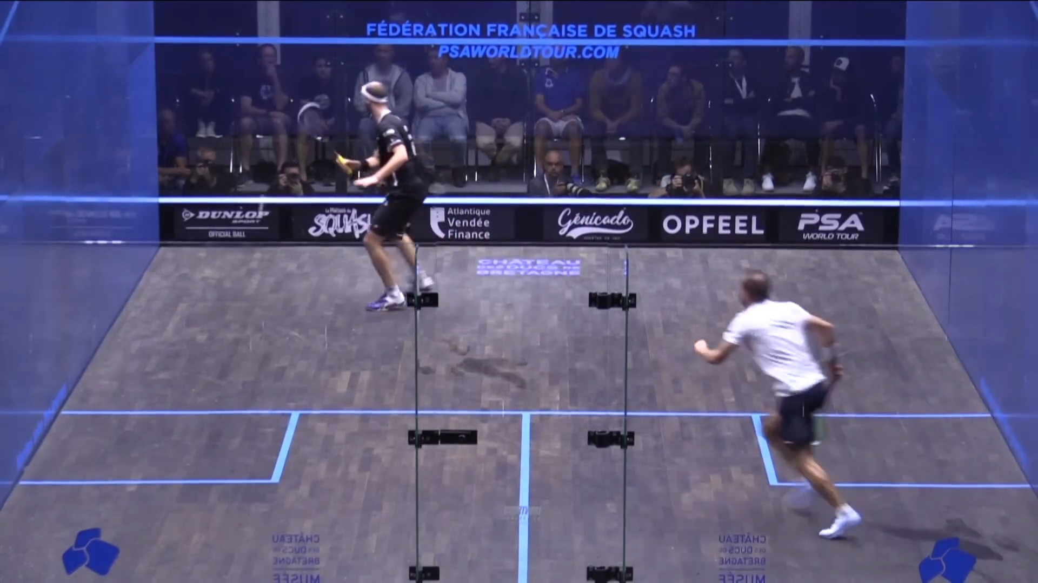
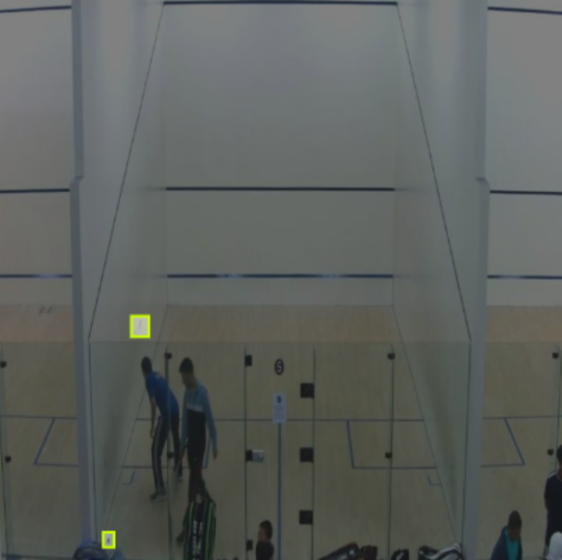
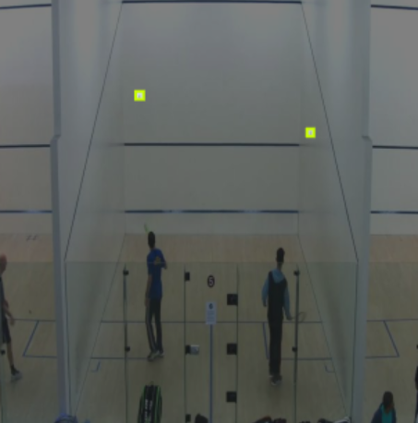
Dataset (Downloaded from RoboFlow)
424 labelled images
1+ balls labelled per image
Court: wooden ground, white walls

Slide 4
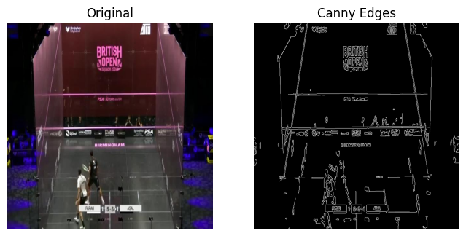
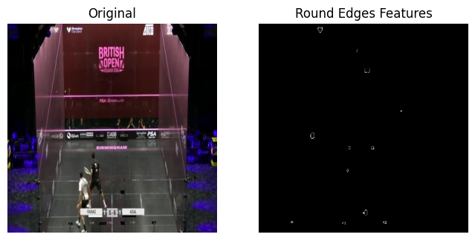
Canny Edge Filter
Optimize model with Canny Edge Filter
Remove “obviously” incorrect edges (i.e. straight lines)

Slide 5
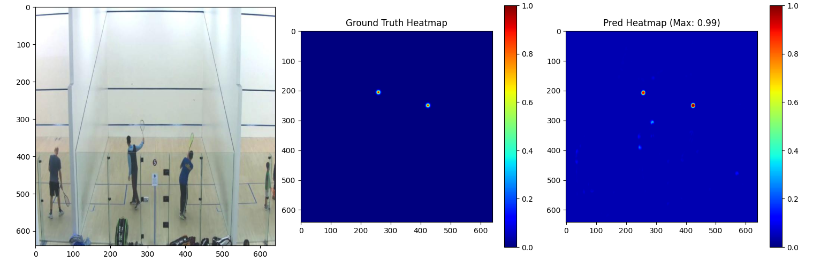
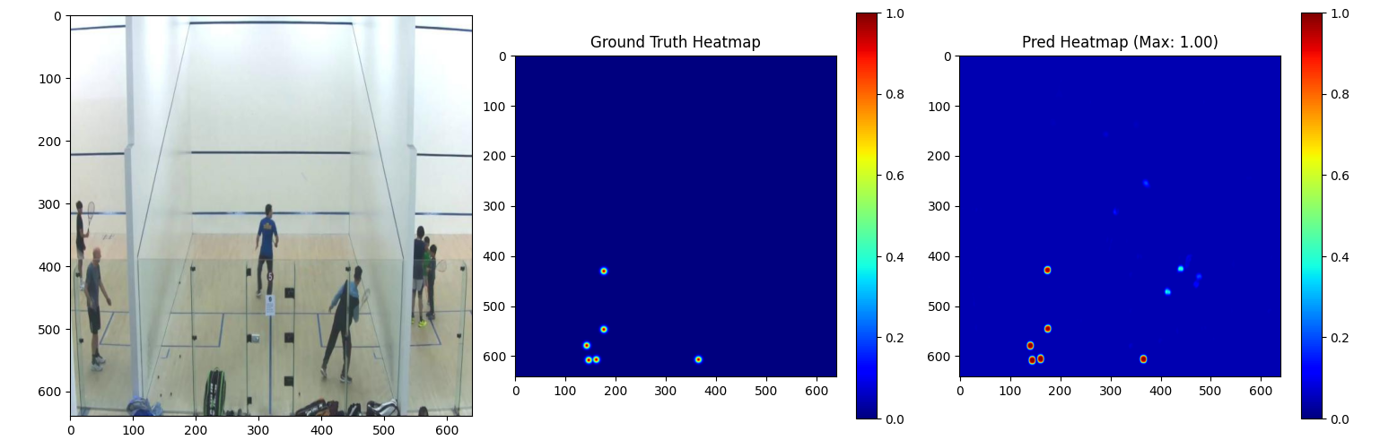
Model
- Used an Encoder-Decoder Model (w/ downsampling, then upsampling)
- Generated a heatmap
- Loss Function: Modified Focal Loss
- Better to predict false positives than false negatives
- Parameters: Alpha, Beta, Ball Position weight

Slide 6
Kalman Filter
A Kalman Filter smooths noisy detections from model
Maintains an accurate ball position even when individual frames have poor detections, motion blur, or partial occlusions.

Slide 7
Live Demo

Slide 8
Future Steps
Train and test on more diverse datasets (different style courts, color balls, camera angles, etc.)
Use real-time inference to train a Squash “Referee” -> learn how to track the points tally and combine ball tracker with player identifier to learn to classify obstruction calls

